Slide 1
Intro to Data Analytics
data -tables, entities and attributes, variable types, statistics.

Slide 2
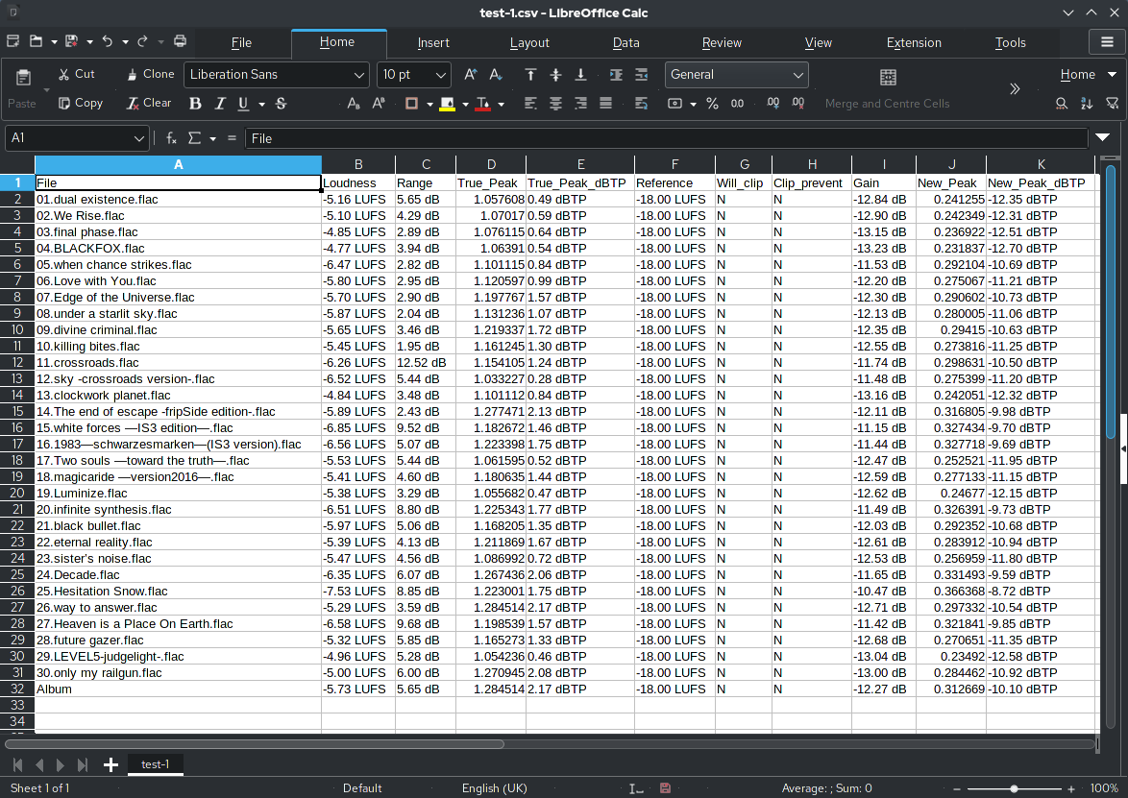
Spreadsheet Paradigm- (snapshot of reality)

Slide 3
Spreadsheet Paradigm
Spreadsheets: Rows and Columns
Columns: attributes, “features”, or variables
Rows: “entities”

Slide 4
Spreadsheet Paradigm
Rows: Individuals.
Columns: age, gender, occupation.
Rows: Countries.
Columns: temperature, latitude, main exports, population
Rows: Products
Columns: Price, Cost per unit, time to manufacture 1 unit

Slide 5
Variable types
Two main types
Qualitative/Categorical (e.g., colour, type, brand)
Quantitative/Continuous (e.g., speed, length, price, time, weight)
From a comp-sci standpoint: (string, int, float).
From an analytical standpoint this will influence the kind of statistics we look at

Slide 6
Measuring Categorical Variables
Frequencies
Percentages
Proportions
Barplots
Pie-Charts
Frequency tables/ 2D tables

Slide 7
Measuring Quantitative variables (Central tendency)
Mean
Median
Mode
Histograms
Density-plots
Box-plots

Slide 8
Measuring Continuous variables (Frequency matters)
Frequency refers to how many observations at a given value or range of values for a continuous variable.
The Shape of the distribution matters.

Slide 9
Measures of dispersion
Range (Maximum - Minimum)
Standard deviation/ Variance
Variance is not easy to interpret. We will use variance in number crunching not to present data to help understand something.
SD we can make sense out of. It is basically the average distance from the arithmetic mean for our data points.
IQR
Visualizations also speak to these

